Slide 1
WEB DEVELOPMENT TOOLS AND METHODS
MOVIE BOOKING PORTAL
KRITHIKA COOMARASWAMI
NUID 001731509

Slide 2
MAJOR ENTITIES
CUSTOMER
The Customer inherits the Person class. He is the major entity in this application and is responsible for a number of roles. The important attributes are Username, Password, CustomerID.
CINEMA
This application is responsible for booking movies and hence theatre is an entity and it will consist of many screens and the screens will different show timings and will screen different movies.
SYSTEM
The Admin will maintain the details regarding Movies, Customers and Employees. He will manage the whole application.
MOVIE
The application revolves around this entity. Every Cinema theatre will screen many movies and each movie is identified with its name, movieId, cast, rating.
SCREEN
Every cinema will have many screens and each screen will be uniquely be identified with its ScreenId, Movie, Showtime and Seats available.

Slide 3
SHOWTIME
Every screen and movie will have different show timings and hence it can be identified by MovieId, CinemaId, ScreenId and ShowTime.
ACCOUNT DETAILS
Every customer will have his own unique account details consisting of CustomerId, AccountName, AccountNumber, AccountType and Expiry.
BOOKMARK
Customer can bookmark every movie he is interested in and this entity is identified with the MovieId and CustomerId.
COMMENTS
Customers can give comments for every movie and Screen. MovieComments will be identified with the MovieId and ScreenComments will be identified with the CinemaId and ScreenId.
MOVIERATING
The Customer can rate the movie and screen if he wishes to. Every rating is identified with the MovieId and ScreenId respectively.

Slide 4
MAJOR ROLES
Roles of Customer
Logs into the system if he already has an account or registers for a new account.
Searches for a particular movie
Checks the screens for the selected movie.
Chooses a particular showtime for that movie.
Checks the seats and selects the seats available
Makes the payment
Gives comments for Movies and Screens
Can also rate the movies
Can bookmark a favorite movie

Slide 5
Roles of System
Takes the user to the index page everytime he logs in
Pulls the movie list and details from the database when the user requests for the information
Provides the show time and screen details to the user from the database
Stores the comments given by the user
Stores the ratings into the database
Emails the ticket to the user after booking
Stores the booking information of every user
Deletes the information related to a particular movie from user dispaly once it has been stopped screening.
Validates the user credentials
Adds new movies into the database
Updates the information regarding screens and show timings in the database
Gives the authorization to the system to remove movie details

Slide 6
BUSINESS IDEA
The Movie Booking portal application makes use of Spring and Hibernate concepts to bring ease into the flow of the system and handle dynamic processing with the database. E-Ticketing enables the users to book movies from anywhere and anytime easily. It lets the users register for an account and then have their own login credentials. It enables the users to search for their movies of interest by bookmarking them. The customers can search for movies and select a particular movie. They can also choose their favorite screens and show timings. The users are given provisions to give comments and ratings for Movies and Screens which will guide the customers in future to make bookings. The system updates the database dynamically as and when the admin makes changes or when a customer performs booking. The system handles payment and confirmation messages with the customer. The admin is responsible for any changes in the database which will reflect in the webpage.
Goals of the System
To provide anywhere, anytime service for the customers.
To minimize the number of staff at ticket counters.
To promote the film on the Internet.
For the customer to choose from different seats and refer ratings and comments
To increase the profit.
To obtain information on the booking record.

Slide 7
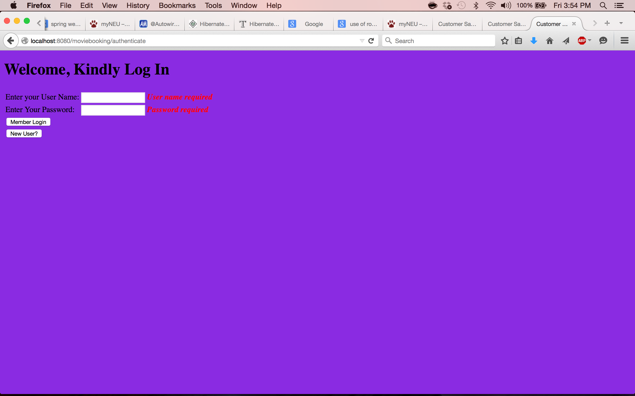
OUTPUT SCREENSHOTS

Slide 8
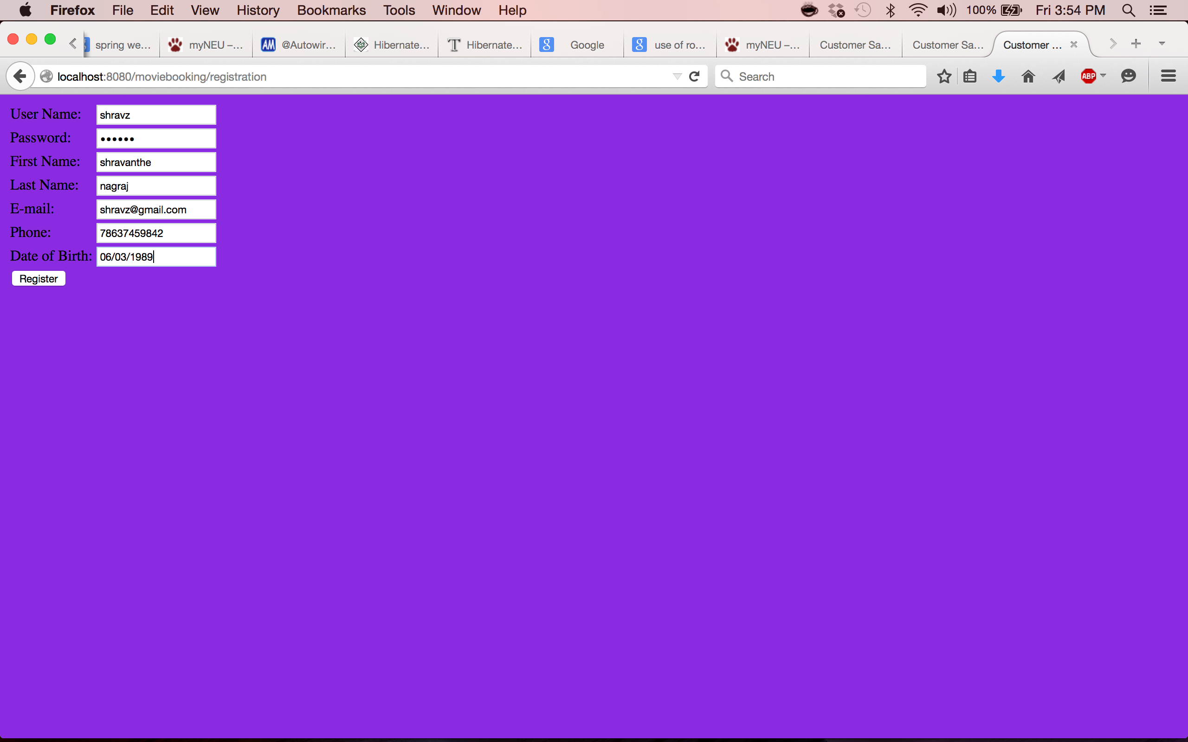
REGISTRATION PAGE

Slide 9

LOGIN PAGE

Slide 10
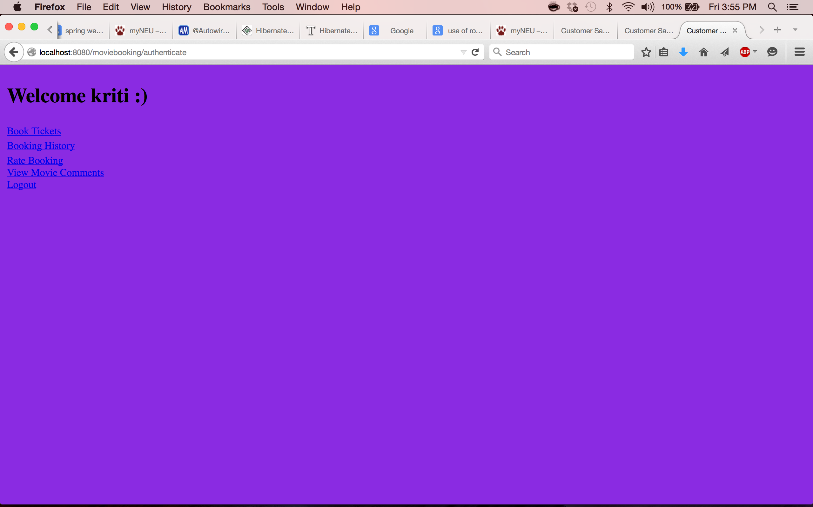
HOME PAGE

Slide 11
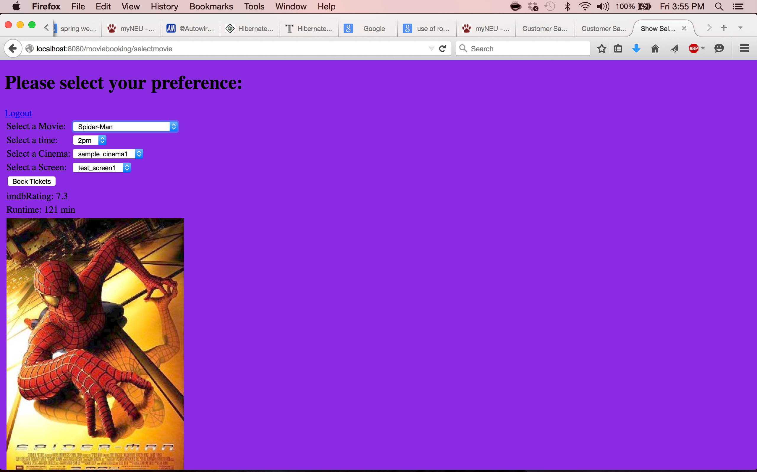
BOOKING PAGE

Slide 12
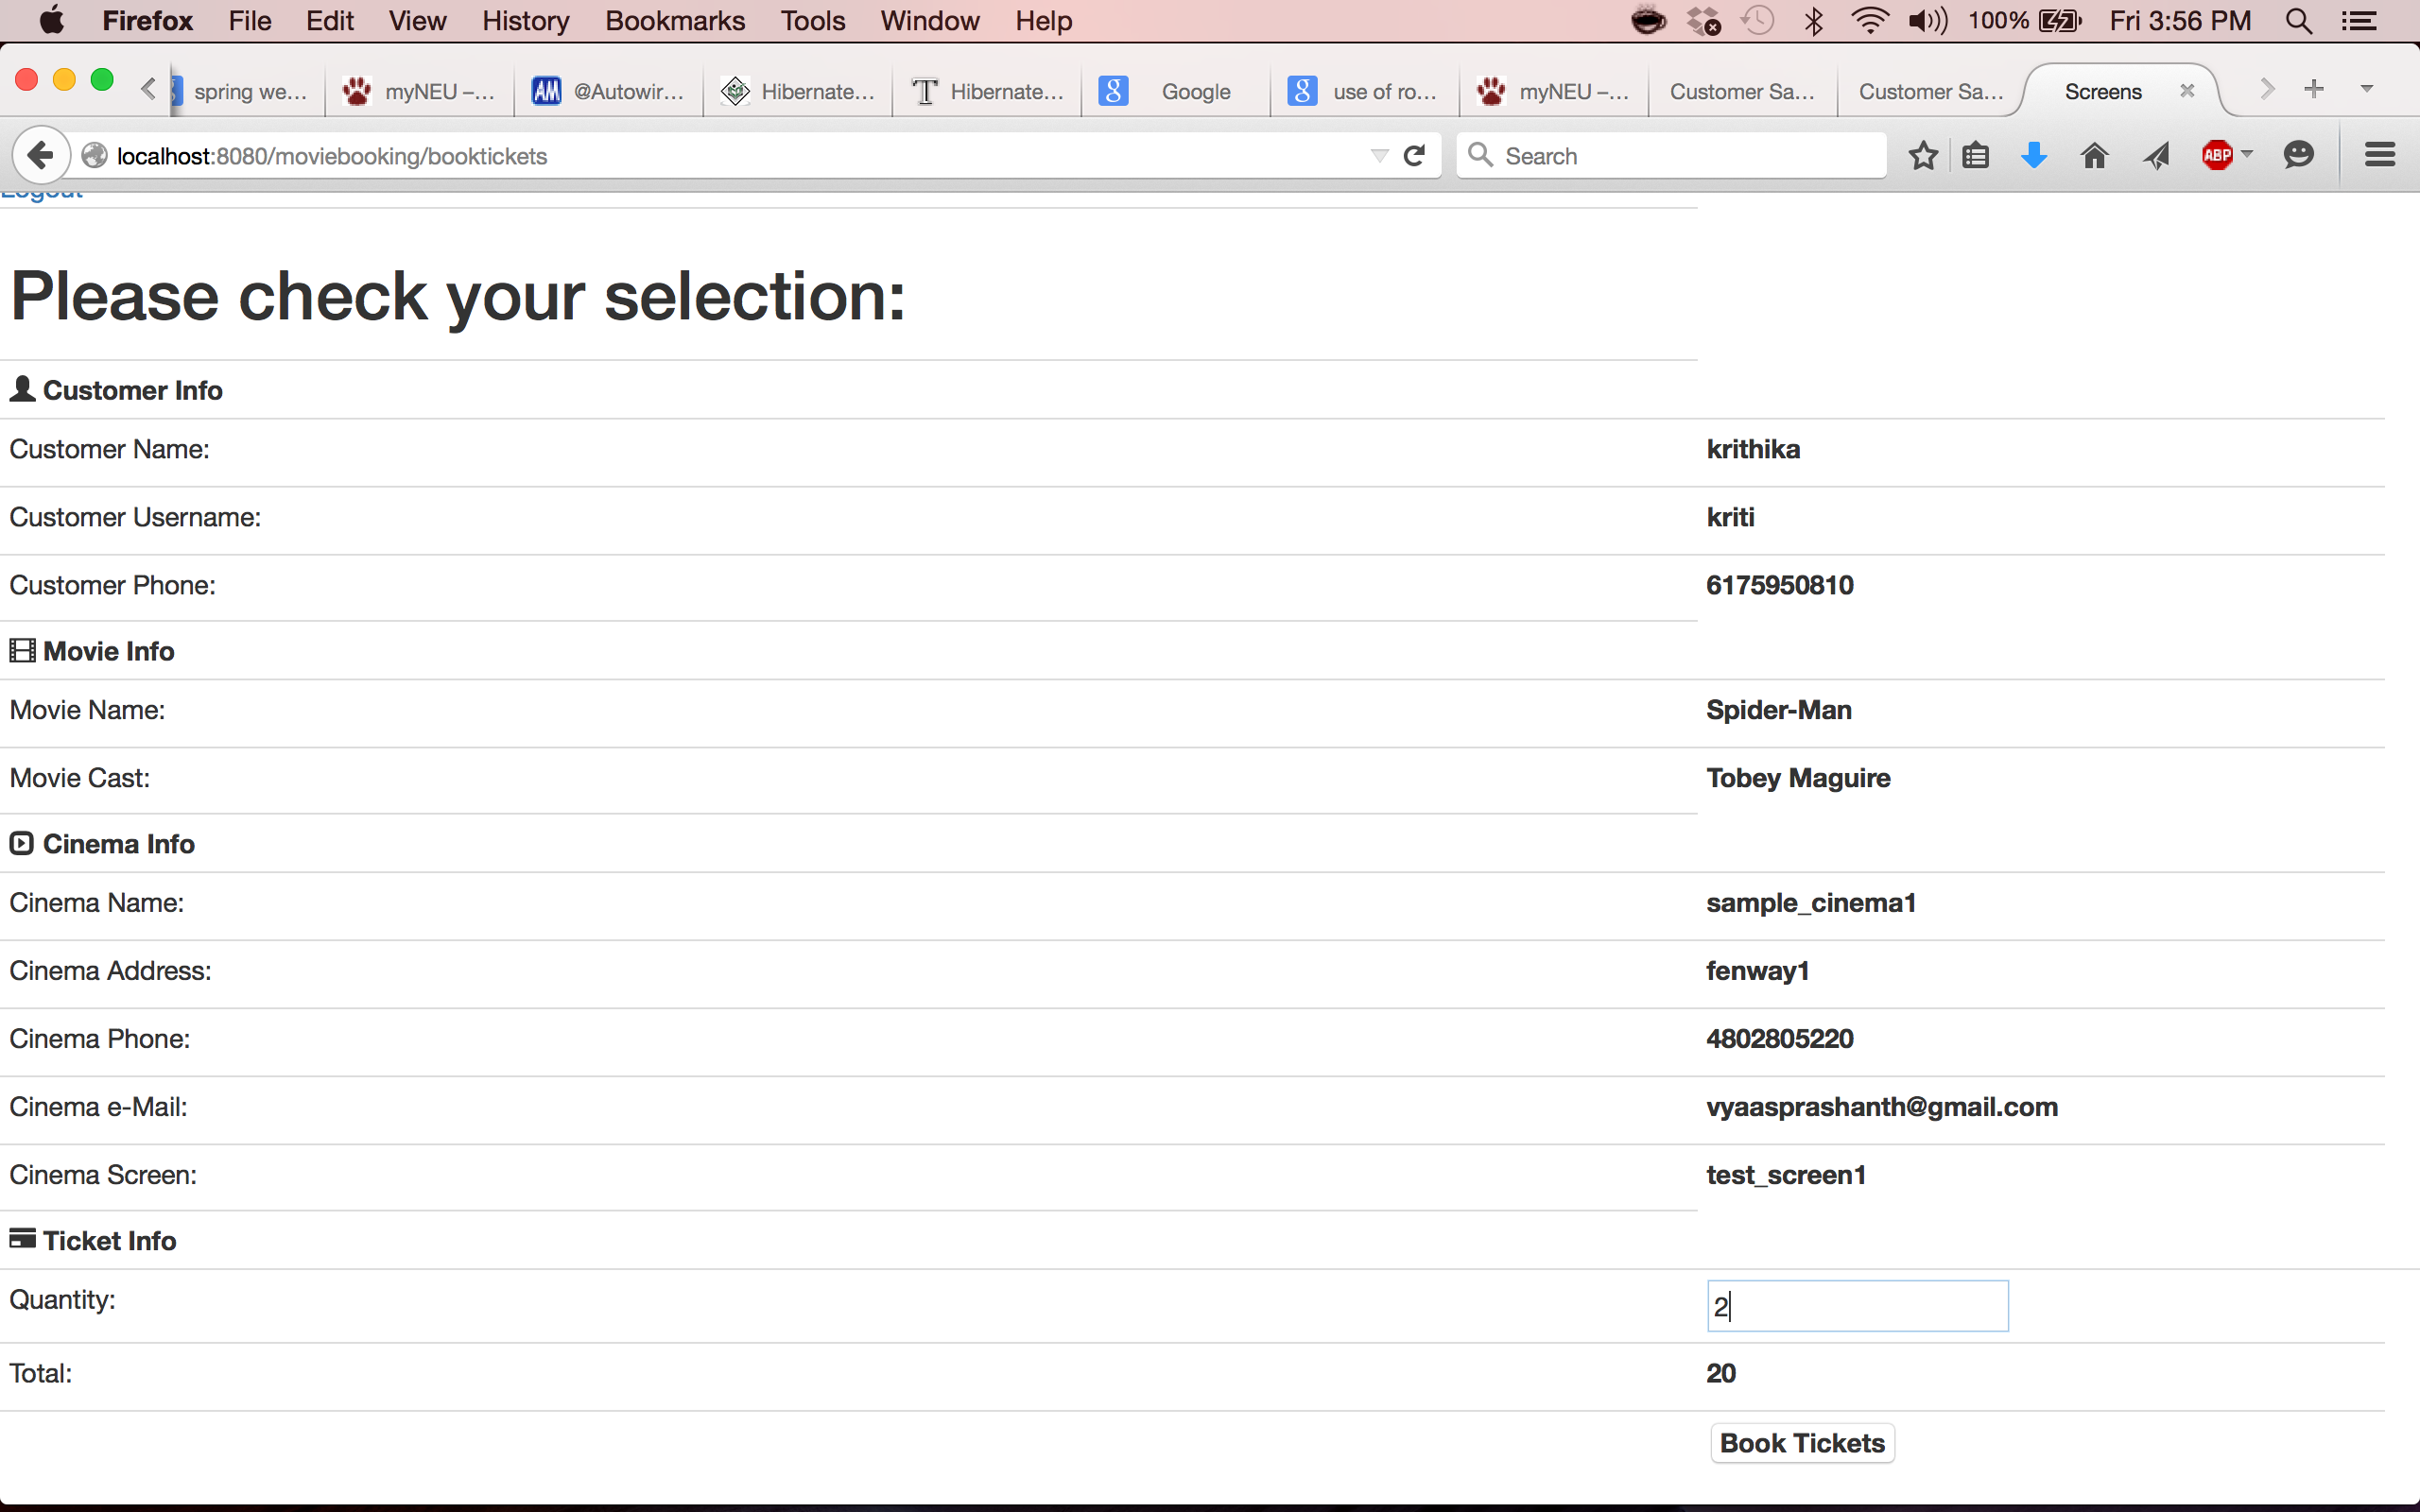
TICKET PAGE

Slide 13
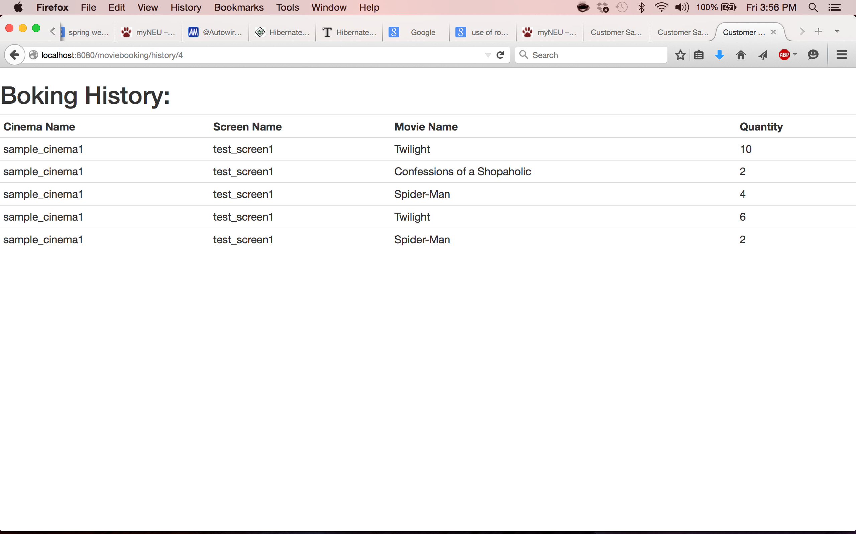
BOOKING HISTORY

Slide 14
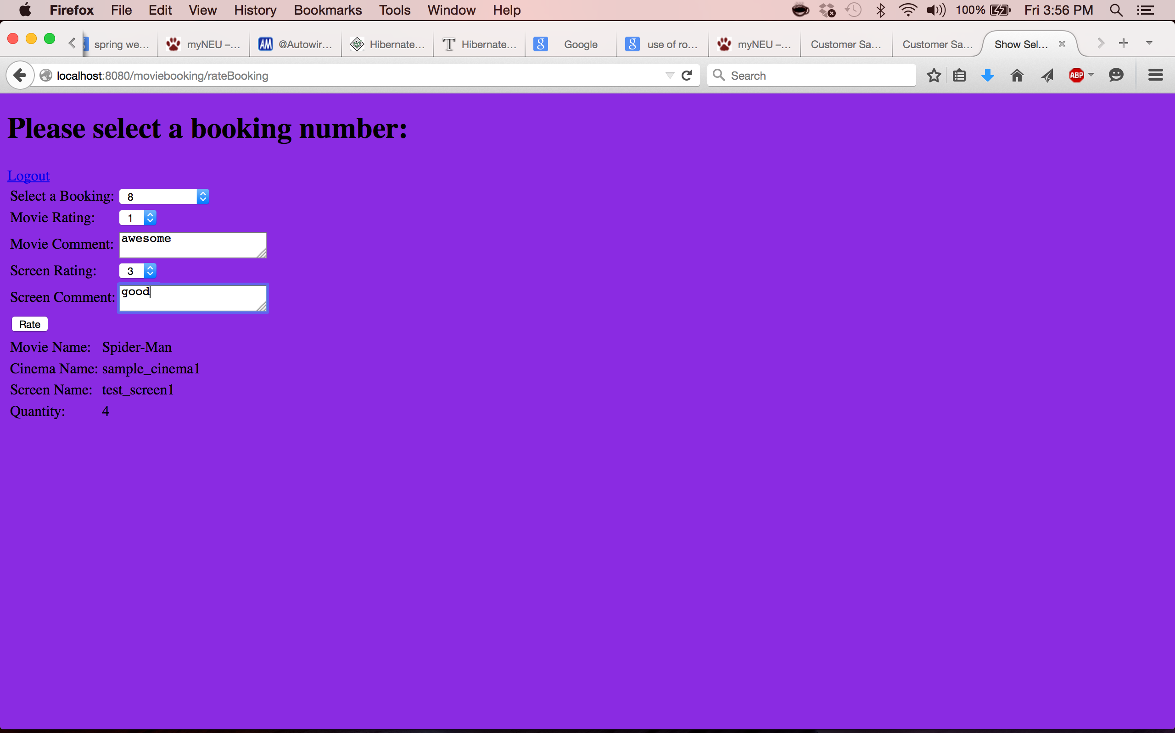
RATING PAGE

Slide 15
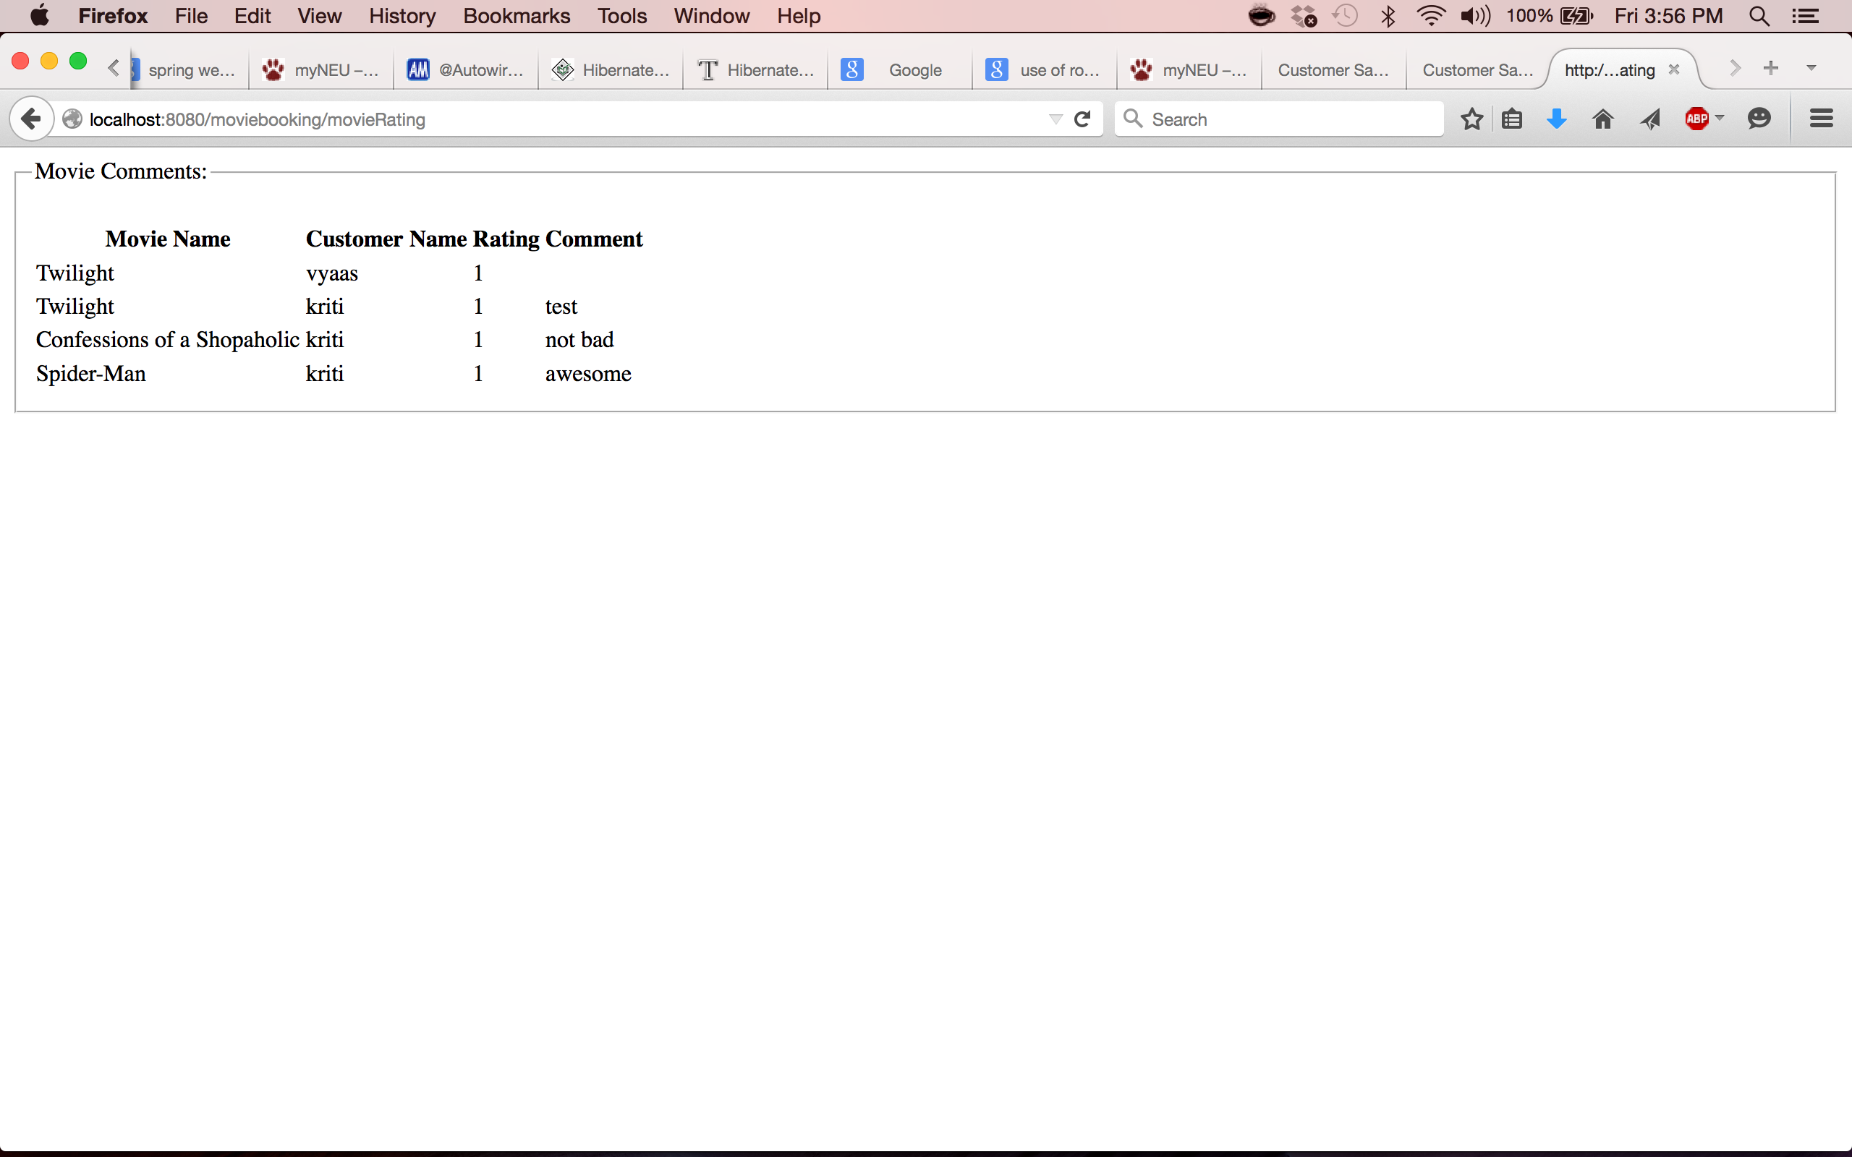
COMMENTS PAGE

